Slide 1
BCSE103E- Computer Programming: JAVA
Dr. S. A. AMUTHA JEEVAKUMARI
Assistant Professor (Sr.)
School of Computer Science and Engineering
VIT - Chennai

Slide 2

Java Packages
PACKAGE in Java is a collection of classes, sub-packages, and
interfaces.
It helps organize the classes into a folder structure and make it easy to locate and use them.
More importantly, it helps improve code reusability.
Each package in Java has its unique name and organizes its classes and interfaces into a separate namespace, or name group.
Package in java can be categorized in to two forms :
Built-in Packages
User-Defined Packages
Advantages :
It categorizes the classes and interfaces. so, they can be easily maintained. It provides access protection.
It removes naming collision.
Re-usability and Data Encapsulation
CSE1007-Java Programming

Slide 3
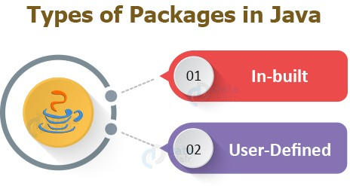
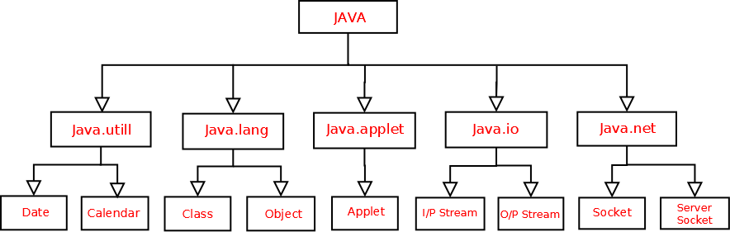
Types of Packages
CSE1007-Java Programming

Slide 4
Built-In Packages
The Java API is a library of prewritten classes, that are free to use, included in the Java Development Environment.
The library contains components for managing input, database programming, and much much more.
The complete list can be found at Oracles website:
https://docs.oracle.com/en/java/javase/15/docs/api/index.html.
The library is divided into packages and classes.
To use a class or a package from the library, you need to use the import
keyword:
Example :
import package.name.Class; import package.name.*;
import java.util.Scanner;
// Import a single class
// Import the whole package
// java.util is a package,
// while Scanner is a class of the java.util package.
CSE1007-Java Programming

Slide 5
Example-1 : Java Package
import java.util.Scanner;
// import java.util.*;
class MyClass {
public static void main(String[] args) { Scanner myObj = new Scanner(System.in); System.out.print("Enter username");
String userName = myObj.nextLine(); System.out.println("Username is: " + userName);
}
}
// Output :
// Enter username : Pradeep K V
// Username is: Pradeep K V
CSE1007-Java Programming

Slide 6
User-Defined Packages
Every class is part of some package.
All classes in a file are part of the same package.
You can specify the package using a package declaration: package name ;
as the first (non-comment) line in the file. It can be created using a
keyword package:
Syntax:
package nameOfPackage;
Examples :
package MyPackages; package My_Packages;
// Meaningfull Names
Multiple files can specify the same package name.
If no package is specified, the classes in the file go into a special unnamed package (the same unnamed package for all files).
If package name is specified, the file must be in a sub-directory called name (i.e., the directory name must match the package name).
CSE1007-Java Programming

Slide 7
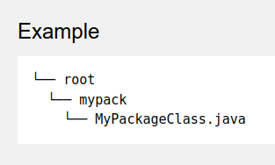
User-Defined Packages
To create User-Defined package, Java uses a file system directory to store them (Like Computers...).
File Structure :
To create a package, use the package keyword:
package mypack; // Save this file as MyPackageClass.java
class MyPackageClass {
public static void main(String[] args) { System.out.println("This is my first package!");
}
}
CSE1007-Java Programming

Slide 8
User-Defined Packages
First Compile the java file :
javac MyPackageClass.java
Now Compile the package :
javac -d . MyPackageClass.java javac -d .. MyPackageClass.java
The -d is a switch that tells the compiler where to put/save the class file
The "." operator represents the current working directory.
The ".." indicates the parent directory.
Note : When we compiled the package as above,
a new folder was created, called "mypack".
Finally, Run the package:
java mypack.MyPackageClass
// This is my first package!
CSE1007-Java Programming

Slide 9
How to access package from another package?
There are three ways to access the package from outside the package.
import package.*;
import package.classname;
fully qualified name.
Example-1 :
//save by A.java package pack; public class A{
public void msg(){
System.out.println("Hello");
}
}
//save by B.java package mypack; import pack.*; class B{
public static void main(String args[]){
A obj = new A(); obj.msg();
}
}
CSE1007-Java Programming

Slide 10
How to access package from another package?
There are three ways to access the package from outside the package.
import package.*;
import package.classname;
fully qualified name.
Example-2 :
//save by A.java package pack; public class A{
public void msg(){
System.out.println("Hello");
}
}
//save by B.java package mypack; import pack.A; class B{
public static void main(String args[]){
A obj = new A();
obj.msg();
}
}
CSE1007-Java Programming

Slide 11
How to access package from another package?
There are three ways to access the package from outside the package.
import package.*;
import package.classname;
fully qualified name.
Example-3 :
//save by A.java package pack; public class A{
public void msg(){
System.out.println("Hello");
}
}
//save by B.java package mypack; class B{
public static void main(String args[]){
//using fully qualified name
pack.A obj = new pack.A();
obj.msg();
}
}
CSE1007-Java Programming

Slide 12
Sub-Packages in Java
Package inside the package is called the subpackage.
It should be created to categorize the package further.
Example : Sun Microsystem has definded a package called java that contains several classes including System, String, Reader, Writer, Socket etc.
These groups represent a specific category
The classes Reader and Writer are for the operation of Input/Output.
The classes Socket and ServerSocket are for networking etc and so on.
Therefore, Sun sub-categorized the java package into sub-packages, such as lang, net, io, etc.
The standard of defining package is :
Syntax :
domain.company.package.
Eg :
in.vit.cse1007
CSE1007-Java Programming

Slide 13
Example : Sub-Packages
package in.vit.cse1007; // Save it as Sub_Package.java
class Sub_Package{
public static void main(String args[]){ System.out.println("Vellore Institute of Technology");
}
}
// 1. Compile Java File :
// 2. Compile Package :
// 3. Run Package :
javac Sub_Package.java javac -d . Sub_Package.java
java in.vit.cse1007.Sub_Package
CSE1007-Java Programming

Slide 14
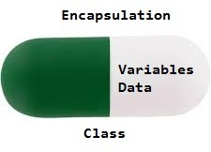
Java Encapsulation
It is a process of wrapping code and data together into a single unit. For Example, a capsule which is mixed of several medicines.
The meaning of Encapsulation, is to make sure that "sensitive" data is hidden from users.
Advantages :
It provides us to control over the data.
It is a way to achieve data hiding. Easy to Test (Unit Testing).
CSE1007-Java Programming

Slide 15
Example-1: Encapsulation
class Area {
// fields to calculate area
int length, breadth;
// constructor to initialize values
Area(int length, int breadth) {
this.length = length; this.breadth = breadth;
}
// method to calculate area
public void getArea() {
int area = length * breadth; System.out.println("Area: " + area);
}
}
class AreaEncapsulation {
public static void main(String[] args) {
// create object of Area
// pass value of length and breadth Area rectangle = new Area(5, 6); rectangle.getArea();
}
}
CSE1007-Java Programming

Slide 16
Example-2: Encapsulation
// Data hiding using the private specifier
class Person {
private int age; // private field
public int getAge() { return age; }
// getter method
public void setAge(int age) { this.age = age; } // setter method
}
class Person_Encapsulate{
public static void main(String[] args) {
Person p1 = new Person(); // create an object of Person
p1.setAge(24); // change age using setter
// access age using getter
System.out.println("My age is " + p1.getAge());
}
}
// My age is 24
CSE1007-Java Programming

Slide 17
Example-3: Encapsulation
// STUD.java in which Java class is fully encapsulated class.
public class STUD{
private String Name; //private data member
public String getName(){ //getter method for name
return Name;
}
public void setName(String name){ //setter method for name
this.Name=name;
}
}
// Student.java in which Instantiated STUD.
class Student{
public static void main(String[] args){
//creating instance of the encapsulated class
STUD s=new STUD();
//setting value in the name member
s.setName("Pradeep K V");
//getting value of the name member
System.out.println(s.getName());
}
}
// Pradeep .K .V
CSE1007-Java Programming

Slide 18
Example-4: Encapsulation I
// Account.java : A Account class which is a fully encapsulated class.
class Account {
private long acc_no; private String name,email; private float amount;
//private data members
//public getter and setter methods
public long getAcc_no() { return acc_no; }
public void setAcc_no(long acc_no) { this.acc_no = acc_no; } public String getName() { return name; }
public void setName(String name) { this.name = name; } public String getEmail() { return email; }
public void setEmail(String email) { this.email = email; } public float getAmount() { return amount; }
public void setAmount(float amount) { this.amount = amount; }
}
CSE1007-Java Programming

Slide 19
Example-4: Encapsulation II
// Acc_Encapsulation.java : Testing the encapsulated class Account.
public class Acc_Encapsulation {
//A Java class to test the encapsulated class Account.
public static void main(String[] args) {
//creating instance of Account class
Account acc=new Account();
//setting values through setter methods
acc.setAcc_no(9445825675L);
acc.setName("Pradeep K V"); acc.setEmail("pradeep.kv@gmail.com"); acc.setAmount(500000f);
//getting values through getter methods
System.out.println(acc.getAcc_no()+" "+acc.getName()+" "+acc.getEmail()+
}
}
// 9445825675 Pradeep K V pradeep.kv@gmail.com 500000.0
CSE1007-Java Programming

Slide 20
Aggregation Has-A Relations in Java
If a class have an entity reference, it is known as Aggregation. It represents HAS-A relationship.
For Example : Employee object contains many informations such as id, name, email-Id etc. It contains one more object named address, which contains its own informations such as city, state, country, zipcode etc. as given below.
class Employee{
int id; String name;
Address address;
...
}
//Address is a class
Employee has an entity reference address, Therefore, Employee HAS-A address. Why Aggregation? (Code Reusability)
CSE1007-Java Programming

Slide 21
Example-1 : Aggregation
class Operation{
int square(int n){
}
class Circle{
Operation op; double pi=3.14;
return n*n; }
//aggregation
double area(int radius){ op=new Operation();
//code reusability (i.e. delegates the method call).
int rsquare=op.square(radius); return pi*rsquare;
}
public static void main(String args[]){ Circle c=new Circle();
double result=c.area(5); System.out.println(result);
}
// Output:78.5
}
CSE1007-Java Programming

Slide 22
Example-2 : Aggregation I
class Address {
String city,state,country;
public Address(String city, String state, String country) { this.city = city; this.state = state;
this.country = country;
}
}
class Emp_Aggregation { int id;
String name;
Address address;
public Emp_Aggregation(int id, String name,Address address) { this.id = id; this.name = name;
this.address=address;
}
void display(){
System.out.print(id+" "+name);
System.out.println(address.city+" "+address.state+" "+address.country);
}
CSE1007-Java Programming

Slide 23
Example-2 : Aggregation II
public static void main(String[] args) {
Address address1=new Address("Kurnool","AP","India"); Address address2=new Address("Chennai","TN","India");
Emp_Aggregation e=new Emp_Aggregation(50396,"Pradeep K V",address1); Emp_Aggregation e2=new Emp_Aggregation(50394,"Nachiyappan",address2);
e.display();
e2.display();
}
// 50396 Pradeep K V Kurnool AP India
// 50394 Nachiyappan Chennai TN India
}
CSE1007-Java Programming

Slide 24
super keyword I
The super keyword is similar to this keyword.
It is used to differentiate the members of superclass from the members of subclass, if they have same names.
It is used to invoke the superclass constructor from subclass.
class Super_class { int num = 20;
// display method of superclass
public void display() {
System.out.println("This is the display method of superclass");
}
}
public class Sub_class extends Super_class { int num = 10;
// display method of sub class
public void display() {
System.out.println("This is the display method of subclass");
}
public void my_method() {
// Instantiating subclass
Sub_class sub = new Sub_class();
CSE1007-Java Programming

Slide 25
super keyword II
// Invoking the display() method of sub class
sub.display();
// Invoking the display() method of superclass
super.display();
// printing the value of variable num of subclass
System.out.println("value of the variable named num in sub class:"
+ sub.num);
// printing the value of variable num of superclass
System.out.println("value of the variable named num in super class:"
+ super.num);
}
public static void main(String args[]) { Sub_class obj = new Sub_class(); obj.my_method();
}
}
Output:
This is the display method of subclass This is the display method of superclass
value of the variable named num in sub class:10
value of the variable named num in super class:20
CSE1007-Java Programming

Slide 26
Example : Invoking super [Method Overriding]
class Animal {
// method in the superclass
public void eat() { System.out.println("I can eat"); }
}
class Dog extends Animal { @Override
public void eat() {
// Dog inherits Animal
// overriding the eat() method
super.eat(); // call method of superclass
System.out.println("I eat dog food");
}
public void bark() { // new method in subclass
System.out.println("I can bark");
}
}
class UseSuperClass {
public static void main(String[] args) {
Dog labrador = new Dog(); // create an object of the subclass labrador.eat(); // call the eat() method labrador.bark();
}
}
/* I can eat
I eat dog food
I can bark
*/
CSE1007-Java Programming

Slide 27
Example : Invoking super constructor
class Superclass { int age;
Superclass(int age) { this.age = age;
}
public void getAge() {
System.out.println("The value of the variable named age"
+ "in super class is: " +age);
}
}
public class Subclass extends Superclass { Subclass(int age) { super(age); }
public static void main(String args[]) { Subclass s = new Subclass(24); s.getAge();
}
}
// The value of the variable named age in super class is: 24
CSE1007-Java Programming

